Slide 1

GENETIC ALGORITHMS
Narra Sathwika Chandra- RA2111003010429
Challa Vijaya Sai Pavan Santhosh-RA2111003010449
Shaik Afsar Basha-RA2111003010452

Slide 2
Classification Of Genetic Algorithms:
Simple Genetic Algorithm (SGA)
Parallel and Distributed Genetic Algorithm (PGA and DGA)
Hybrid Genetic Algorithm (HGA)
Adaptive Genetic Algorithm (AGA)
Fast Messy Genetic Algorithm (FmGA)
Independent Sampling Genetic Algorithm (ISGA)

Slide 3
1. Simple Genetic Algorithm (SGA)
The mechanics of simple genetic algorithms (SGA) are simple involving nothing more complex than copying strings and swapping partial strings
SGA is composed of these operations:
Initialization
Selection
Reproduction
Crossover
Mutation
Evaluation
Termination

Slide 4
2. Parallel and Distributed Genetic Algorithm (PGA and DGA)
Parallel genetic algorithms are designed to take advantage of the inherent parallelism in the genetic algorithm process. This is achieved by dividing the population into smaller sub-populations, each evaluated in parallel by a separate processing unit. This approach can significantly reduce the overall computation time and improve the efficiency of the algorithm.
Distributed genetic algorithms are similar to parallel genetic algorithms but are designed to operate across a network of computers or nodes.

Slide 5
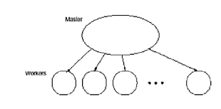
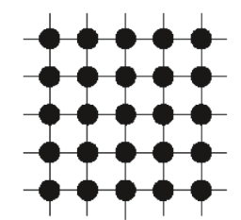
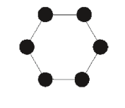
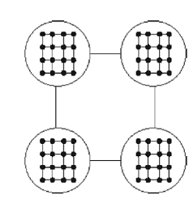
Types Of Parallelism
Master-Slave Parallelization
Fine Grained Parallel Gas
Multiple-Deme Parallel Gas
Hierarchical Parallel Algorithms
Master-Slave: Distributed system where one node coordinates tasks.
Fine-Grained: Parallel processing dividing tasks into smaller components.
Multiple Deme Parallel: Genetic algorithm with multiple sub-populations evolving independently.
Hierarchical: Genetic algorithm with multiple levels of genetic operators and selection

Slide 6
3. Hybrid Genetic Algorithm (HGA)
A Hybrid Genetic Algorithm is designed by combining a variant of an already existing crossover operator with three heuristics
HGA for Travelling Salesman Problem:
Initialization Heuristics
Cross Over
RemoveSharp and LocalOpt
Shuffling

Slide 7
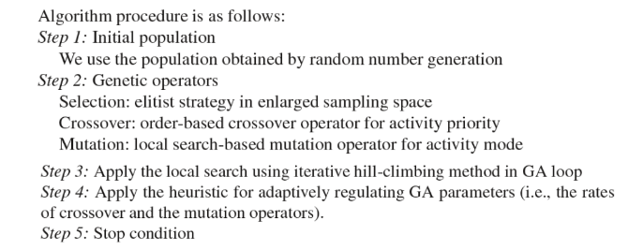
4. Adaptive Genetic Algorithm (AGA)
Adaptive genetic algorithms (AGA) are GAs whose parameters, such as the population size, the crossing over probability, or the mutation probability are varied while the GA is running

Slide 8
5. Fast Messy Genetic Algorithm (FMGA)
The fmGA is a binary, stochastic, variable string length, population based approach to solving optimization problems
The fmGA contains three phases of operation:
the initialization phase Cross Over
the building block filtering (BBF) phase
the juxtapositional phase, which includes various parameters

Slide 9
6. Independent Sampling Genetic Algorithm (ISGA)
Idealized Genetic Algorithm (IGA) allows each individual to evolve completely independently
Partially motivated by the idea of IGA, a more robust GA called Independent Sampling Genetic Algorithm, which proceeds in two phases:
The independent sampling phase-Building block detecting statergy(BBDS)
The breeding phase

Slide 10
Thank You

